Slide 1
Review Rating Predication
BY : Priya Patidar
Internship Batch:30

Slide 2
INTRODUCTION
Research has shown that consumer online product ratings reflect both the customers' experience with the product and the influence of others' ratings.
The opinion information is very useful for users and customers. Businesses can also use the opinion information to design better strategies for production and marketing.
A recent survey (Hinckley, 2015) revealed that 67.7% of consumers are effectively influenced by online reviews when making their purchase decisions.
More precisely, 54.7% recognized that these reviews were either fairly, very or absolutely important in their purchase decision making.
Searching and comparing text reviews can be frustrating for users as they feel submerged with information.

Slide 3
INTRODUCTION
The star-rating, i.e., stars from 1 to 5 on online platform, rather than its text content gives a quick overview of the product quality.
The overall star ratings of the product reviews may not capture the exact polarity of the sentiments.
For instance, a user may rate a product as good and assign a 5-star score while another user may write the same comment and give only 3 stars.
The question that arises is how to successfully predict a user’s numerical rating from its review text content. One solution is to rely on supervised machine learning techniques such as text classification which allows to automatically classify a document into a fixed set of classes after being trained over past annotated data.

Slide 4
PROBLEM STATEMENT
We have a client who has a website where people write different reviews for technical products. Now they are adding a new feature to their website i.e. The reviewer will have to add stars(rating) as well with the review. The rating is out 5 stars and it only has 5 options available 1 star, 2 stars, 3 stars, 4 stars, 5 stars. Now they want to predict ratings for the reviews which were written in the past and they don’t have rating.
So we, we have to build an application which can predict the rating by seeing the review.

Slide 5
Web Scraping Details
Web Scraping done using selenium web driver.
Data for different product like smartphones, laptops, routers is scraped.
Data scraped from amazon.in
Around 20000 product reviews are scrap for this project.

Slide 6
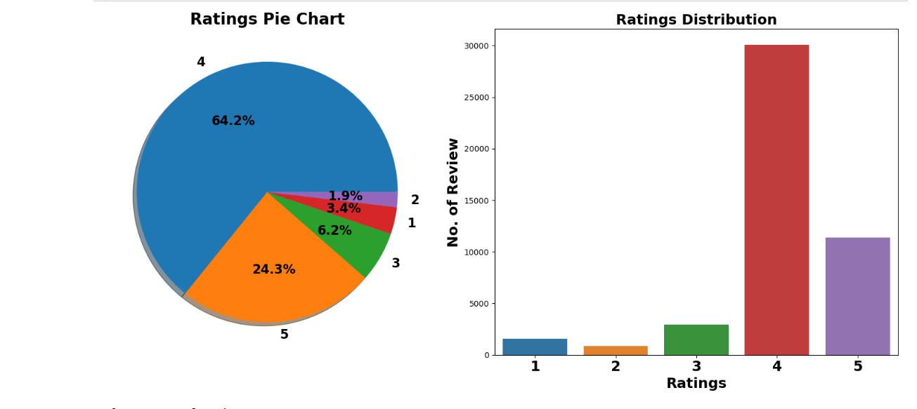
Exploration of Target Variable Ratings
Comment:
1. Around 64% customer given 4- star rating followed by 24% customer given 5-star rating.
2. Average Rating is 4.04.

Slide 7
Data Pre Processing
Convert the text to lowercase
Remove the punctuations, digits and special characters
Tokenize the out the adjectives used in the review and create a new column in data text, filter rame
Remove the stop words
Stemming and Lemmatising
Applying Text Vectorization to convert text into numeric

Slide 8
Word Cloud for getting word sense
Word Cloud is a visualization technique for text data wherein each word is picturized with its importance in the context or its frequency.
The more commonly the term appears within the text being analysed, the larger the word appears in the image generated.
The enlarged texts are the greatest number of words used there and small texts are the smaller number of words used.

Slide 9
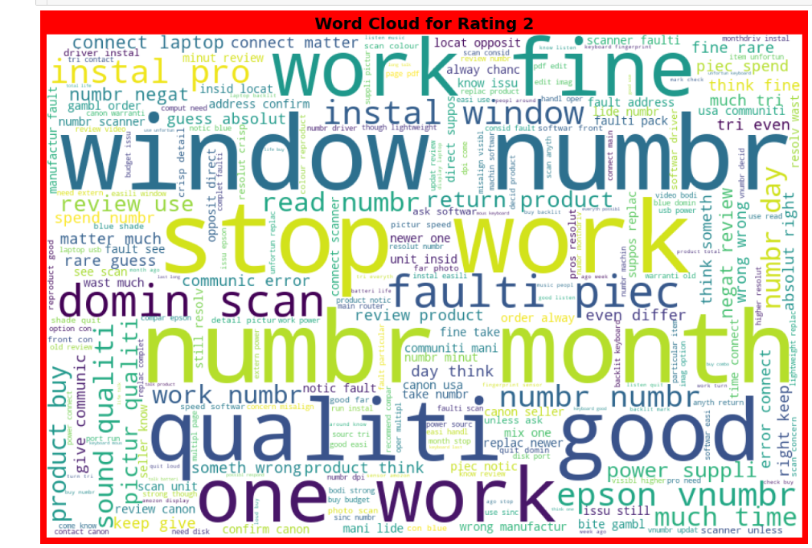

Slide 10
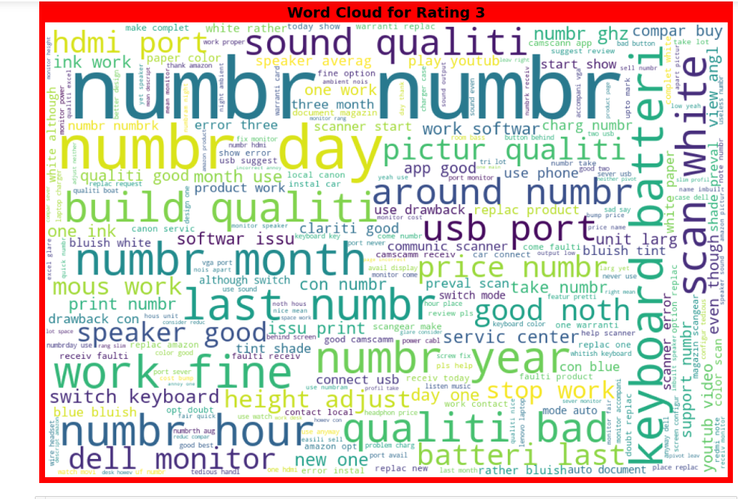

Slide 11
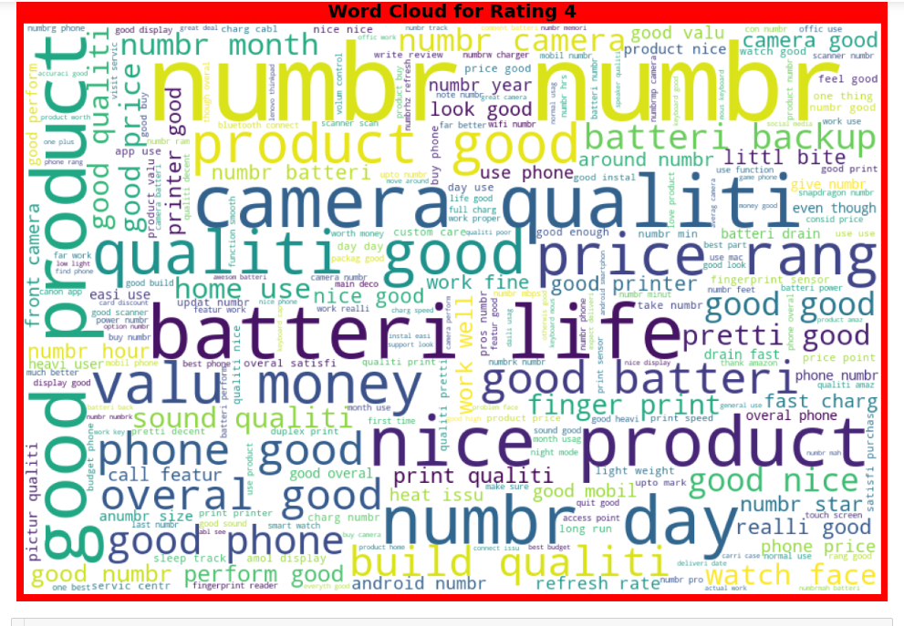

Slide 12
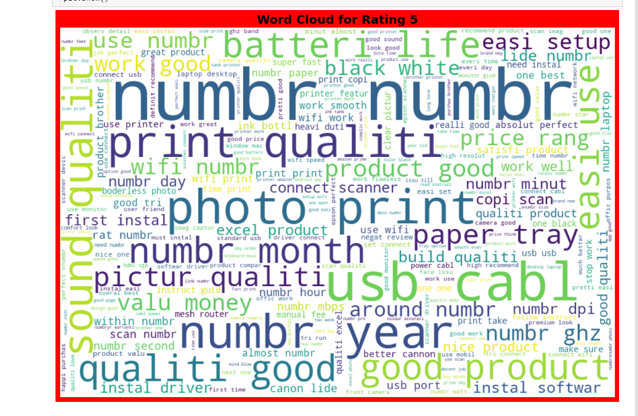

Slide 13
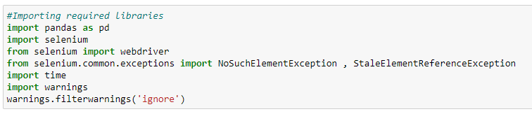
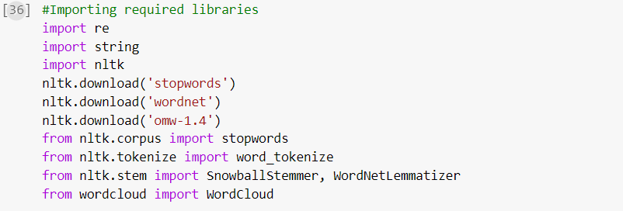
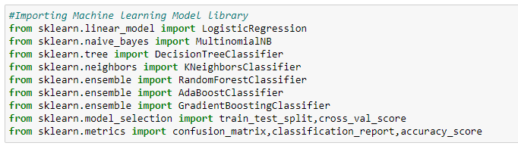
Web Scraping Library used
Text Mining Library used
Machine Learning model building Library used

Slide 14
Machine Learning Model Building
The different classification algorithm used in this project to build ML model are as below:
Random Forest classifier
Decision Tree classifier
Logistics Regression
AdaBoost Classifier
Gradient Boosting Classifier

Slide 15
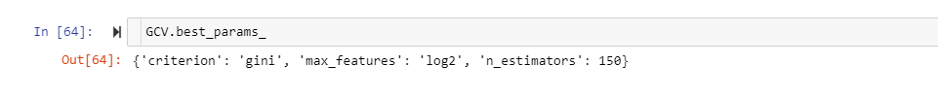
Machine Learning Evaluation Matrix
Random Forest Classifier gives maximum accuracy score.
Hyper parameter Tuning is perform over this best model.

Slide 16
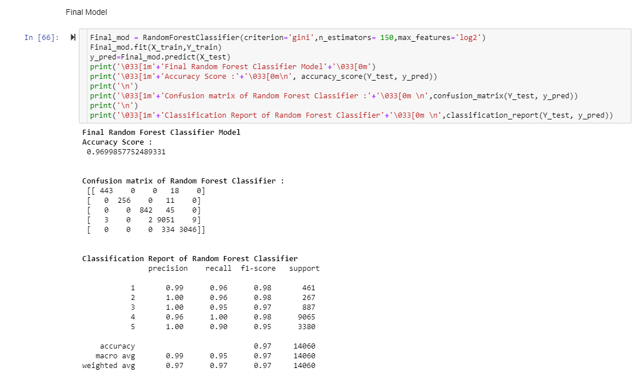
Final ML Model
5-fold Cross validation performed over all model. We can see that Random Forest Classifier gives us good Accuracy and maximum f1 score along with best Cross-validation score. Hyperparameter tuning is applied over Random Forest model and used it as final model.

Slide 17
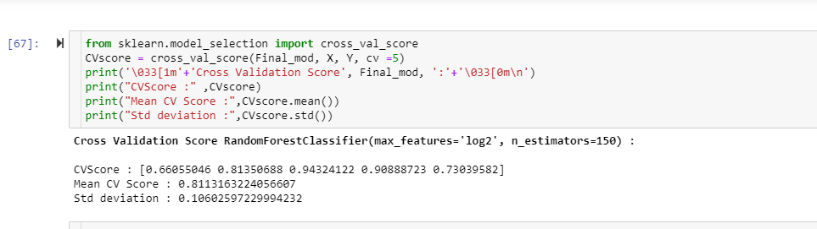
Machine Learning Final Model CV

Slide 18
CONCLUSION
Successfully developed Machine learning model to predict product review ratings.
NLTK library used for text Mining.
Random forest classifier model is best model with accuracy score of 96.99%.

